Slide 1
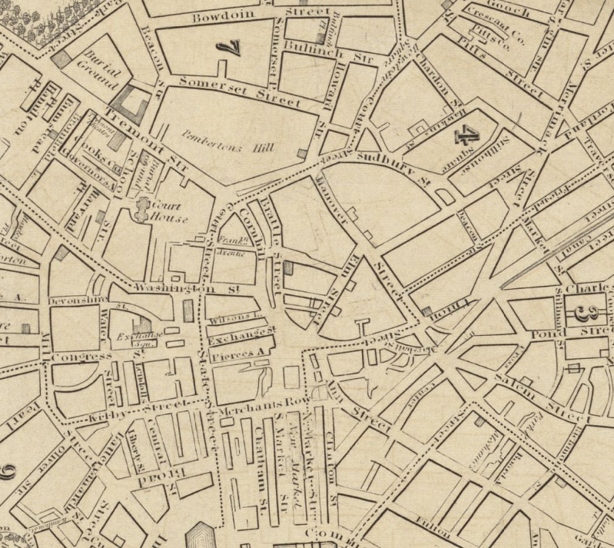
The Hidden History of Abolition Acre
Aeffia Feuerstein
Professor Aylmer
World History I
UMass Amherst Undergraduate Research Conference
April 27th, 2018

Slide 2
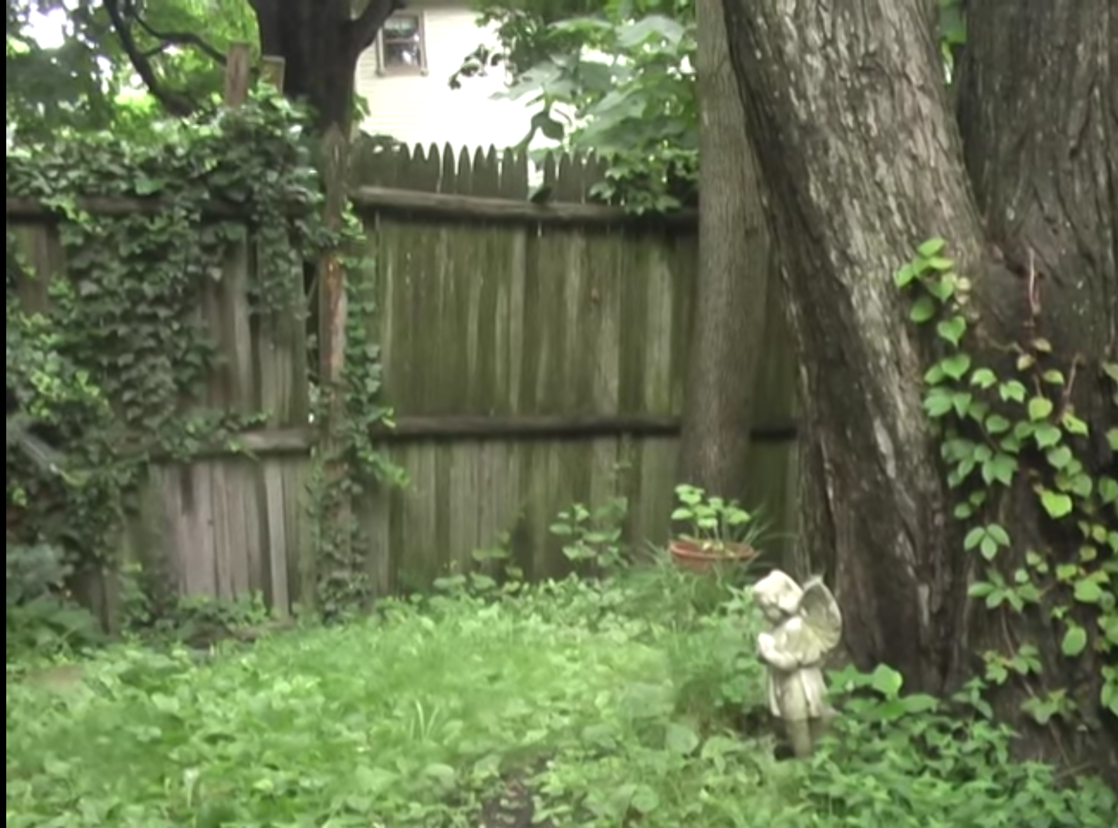
Lancaster Street, Cambridge

Slide 3


Slide 4
1755

Slide 5
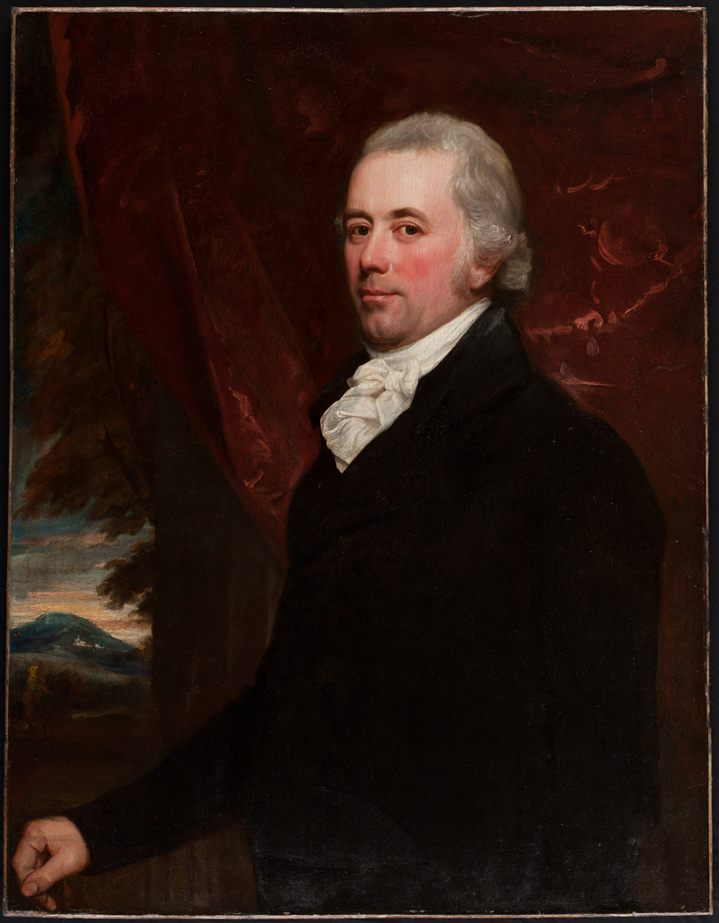
John Codman
  Charlestown, MA
  Ship Captain / Merchant
  SLAVE MASTER
POISONED
Portrait of John Codman III (Grandson of Deceased)

Slide 6



3 Slaves
Mark
Phillis
Phebe

Slide 8
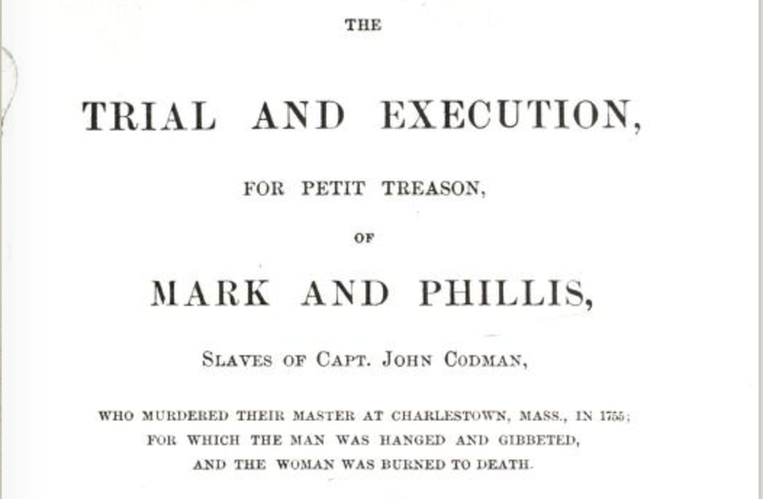

Slide 9
Gallows' Lot
Lancaster Street, Cambridge

Slide 10
Mark
Phillis
Phebe

Slide 11
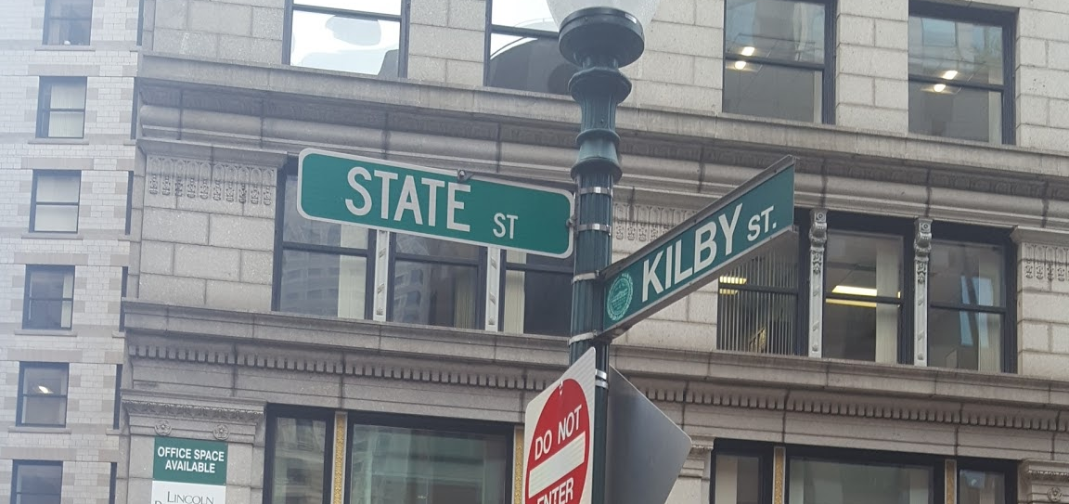

Slide 12
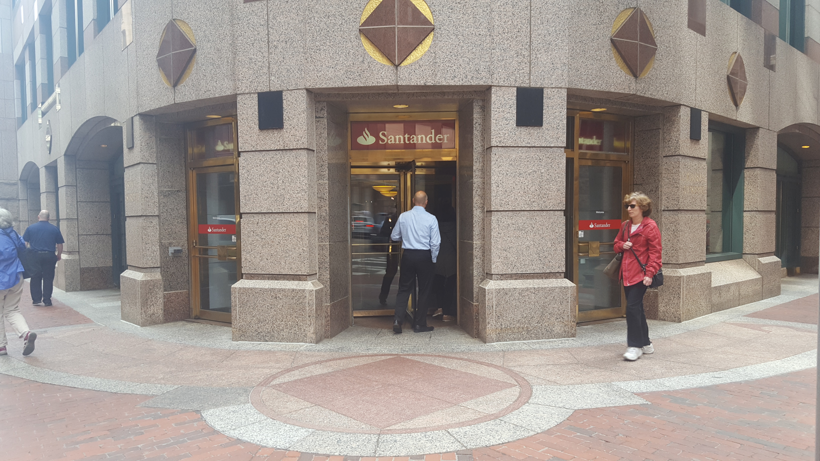

Slide 13
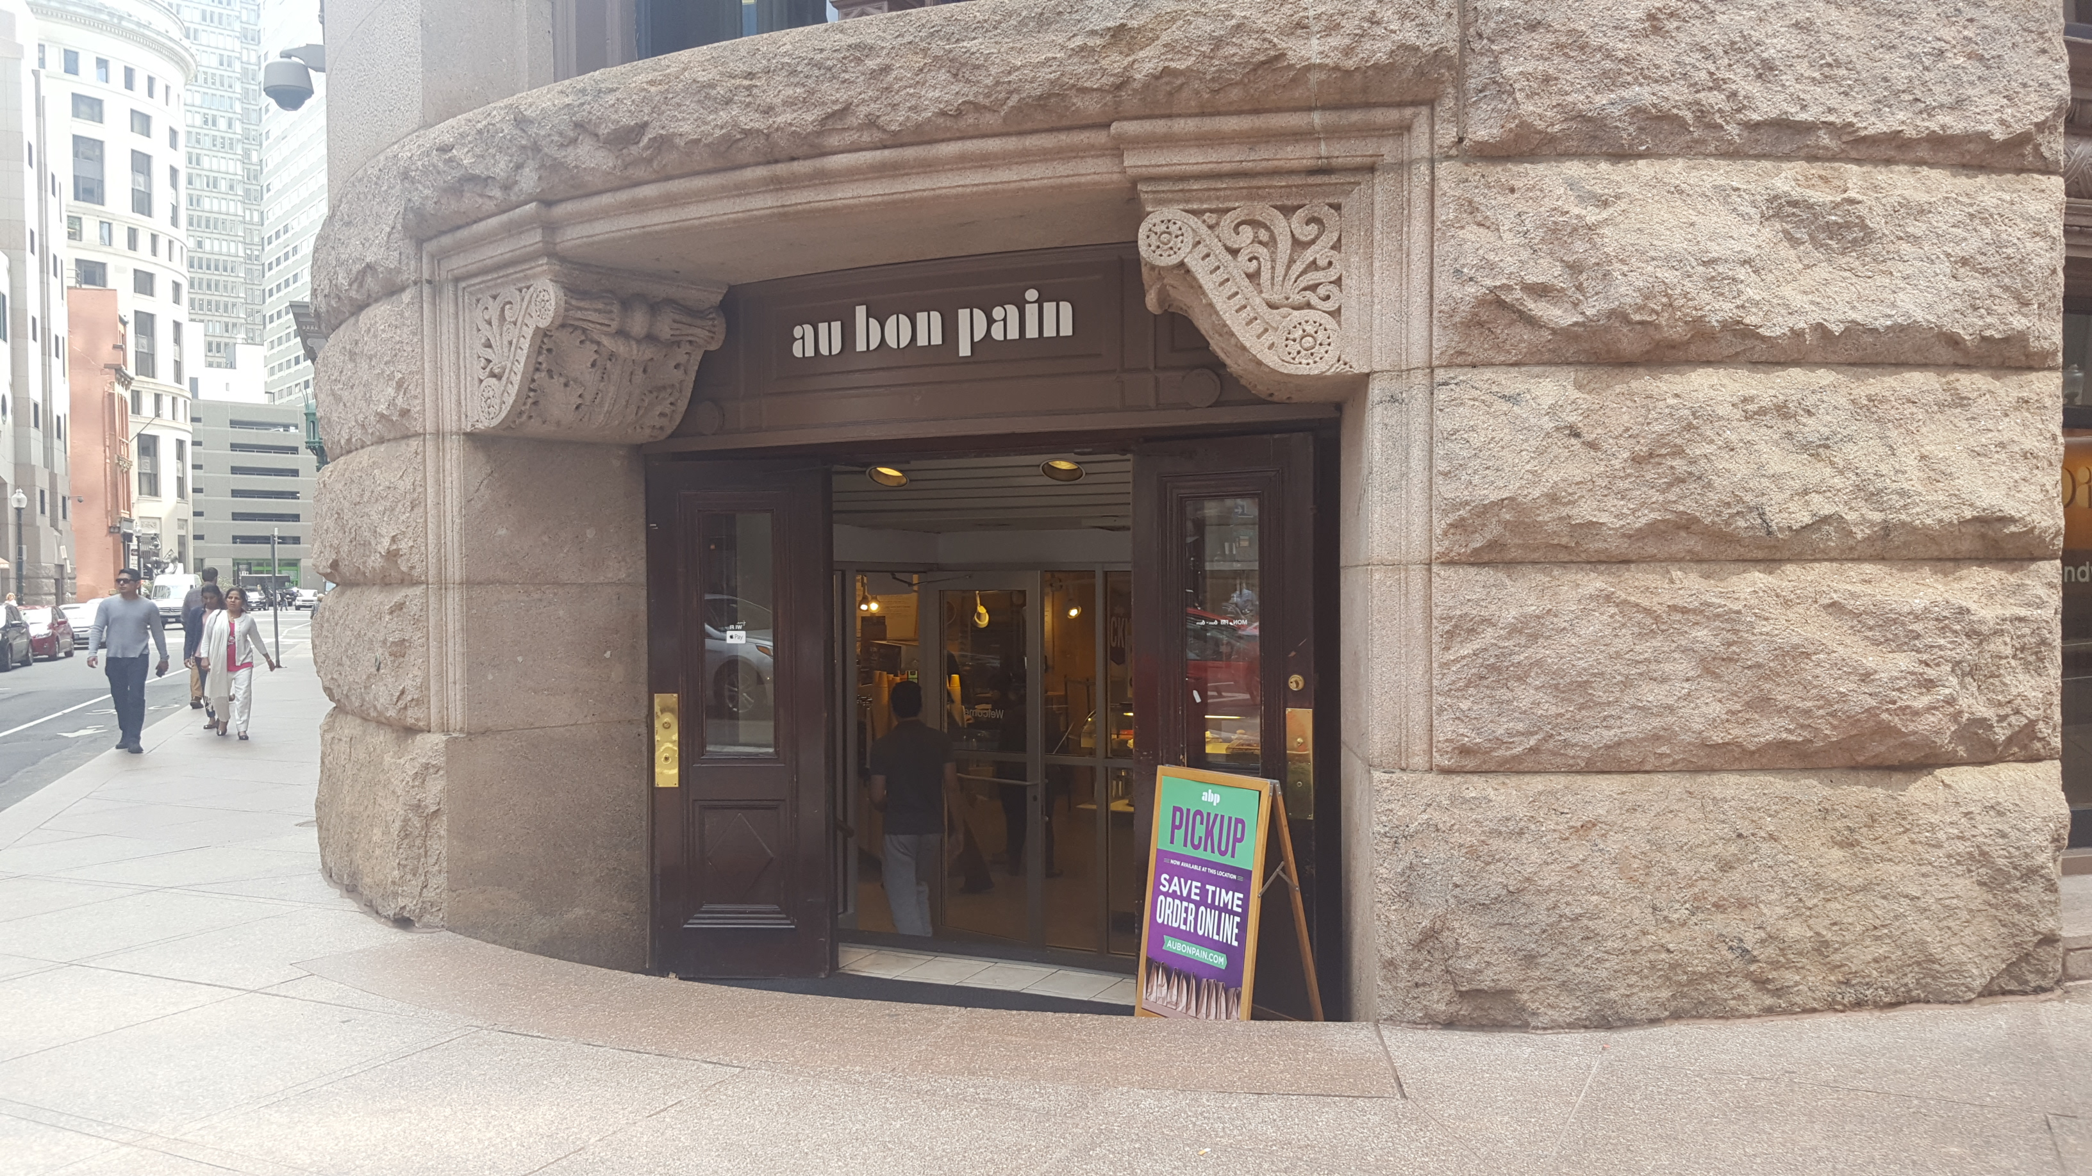

Slide 14
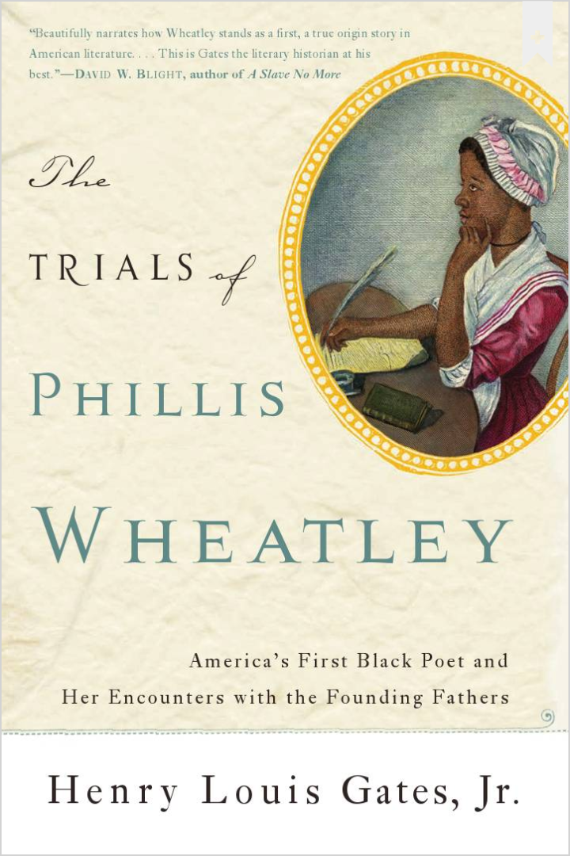
Phillis Wheatley
Black Slave
Travels: Africa – Boston
Wheatley Family (Purchases)
Taught to Read

Slide 15
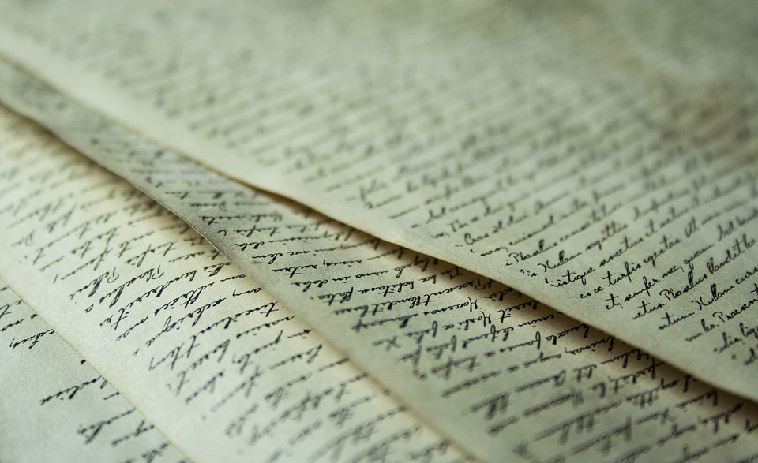
Writing Poetry
Notes:
***

Slide 16
Can an African
write poetry?

Slide 17
1772

Slide 18
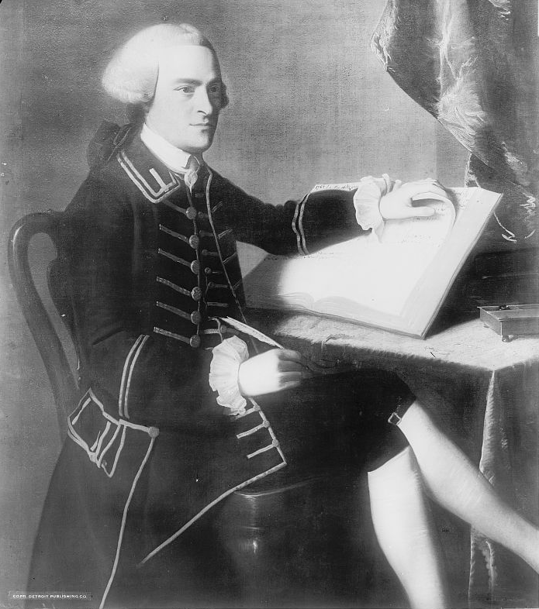
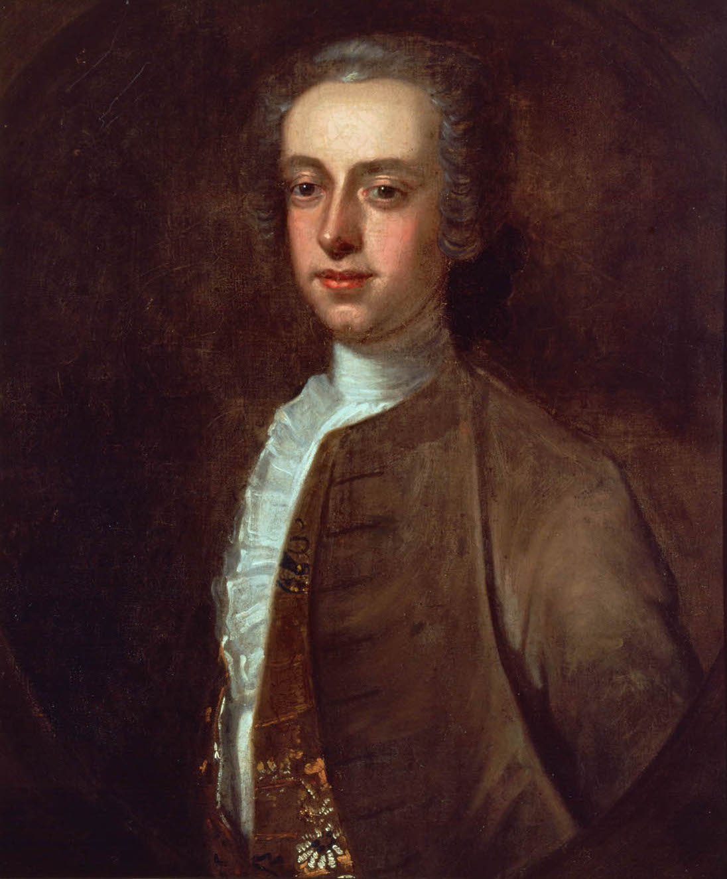
18 Men
John Hancock
Thomas Hutchinson

Slide 19
She Passed.

Slide 20
1806

Slide 21
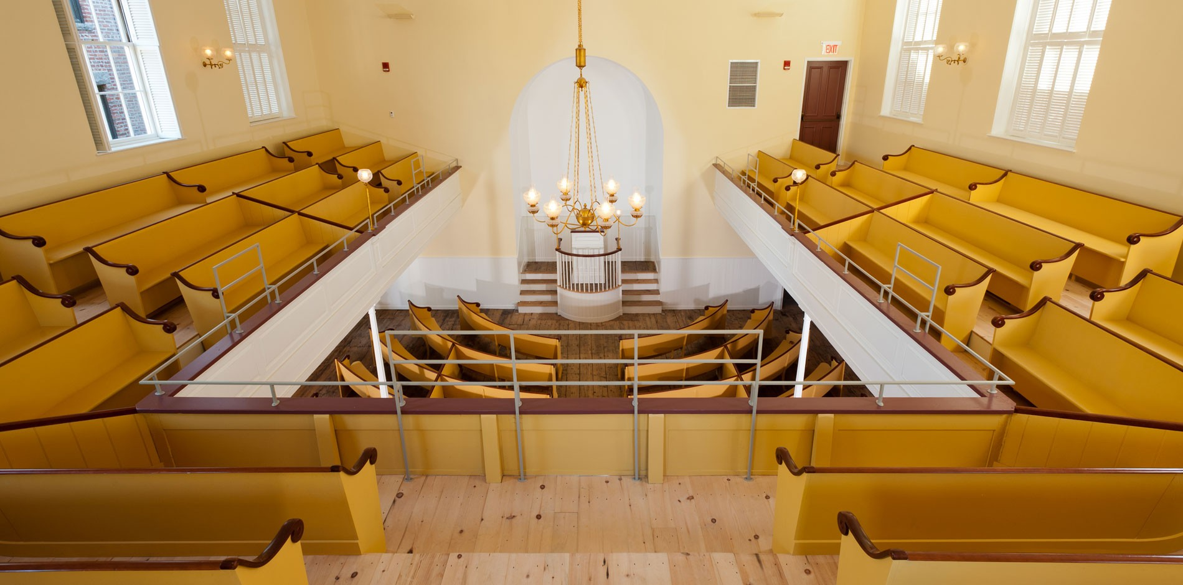
African Meeting House (1806)

Slide 22
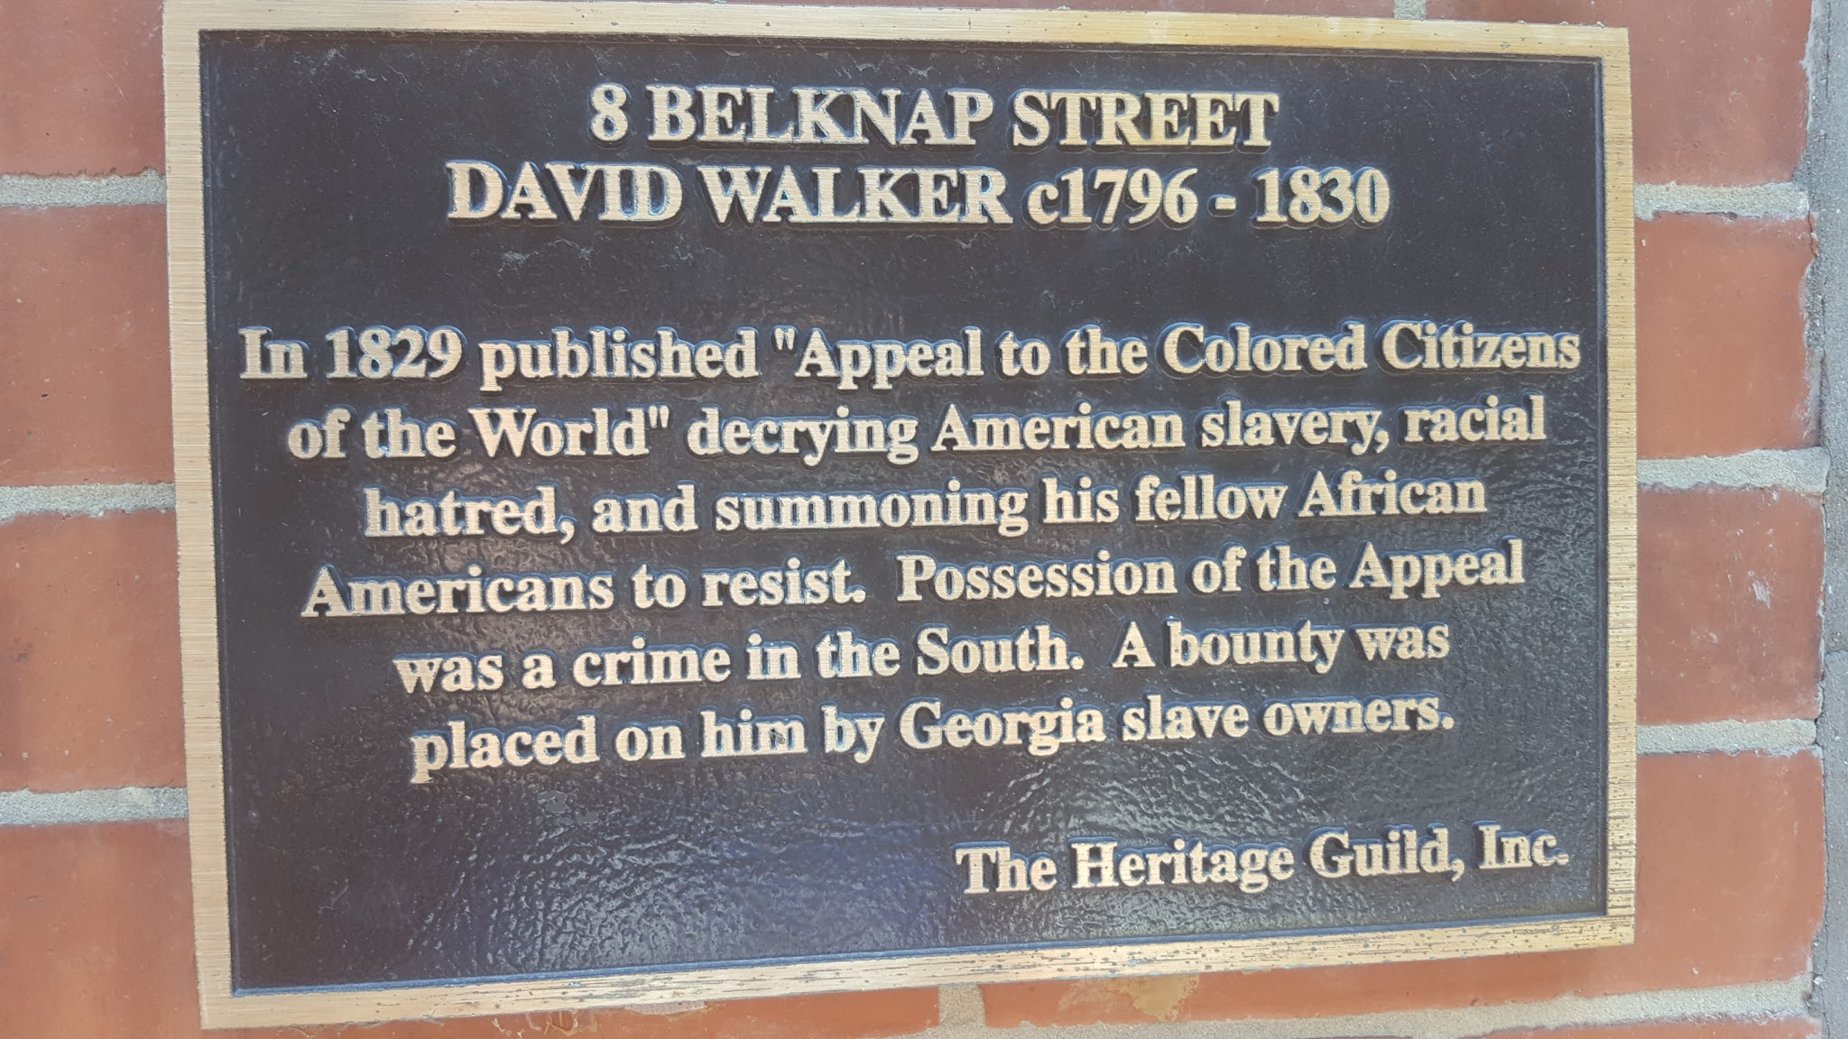

Slide 23
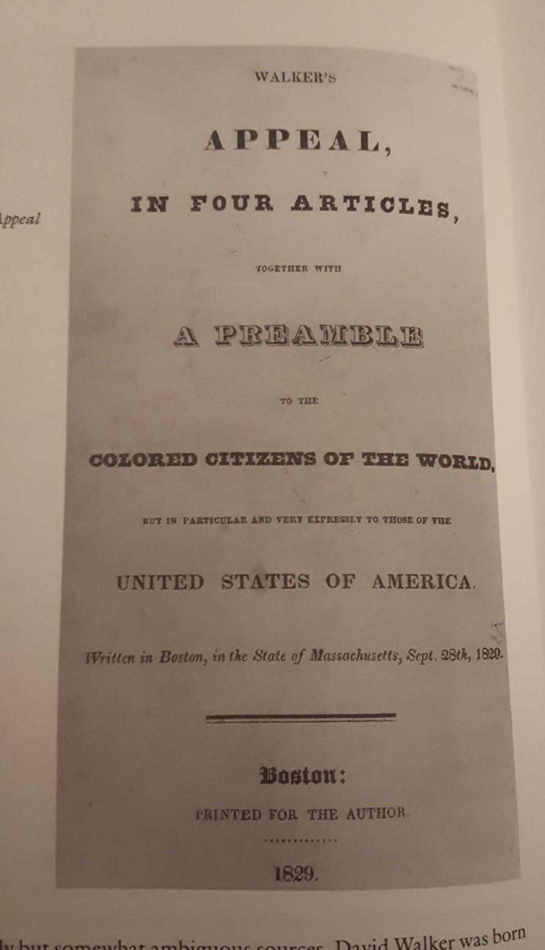
David Walker’s Appeal
Pamphlet → Covertly Given to Slaves
Declaration of Independence
Advocate:
  Revolution!
  At ANY cost…

Slide 24
1830

Slide 25
Mysterious Death of David Walker
???

Slide 26
African Meeting House (1806)

Slide 27
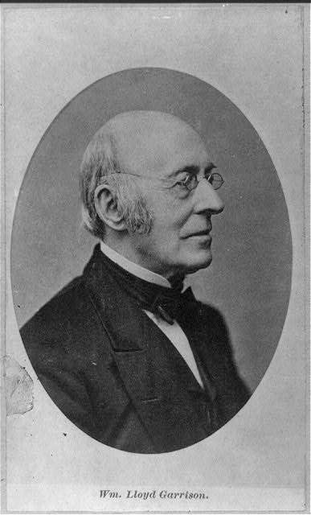
William Lloyd Garrison
Radical Abolitionist
Militant Civic Engagement
  Immediatism
  Moral Suasion
Organizer, Editor, Publisher,
Date Unknown

Slide 28
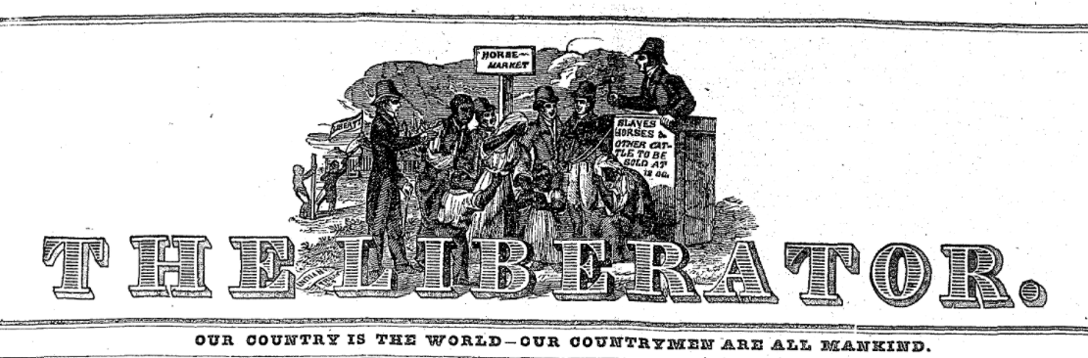
1831 - 1865

Slide 29
1835

Slide 30
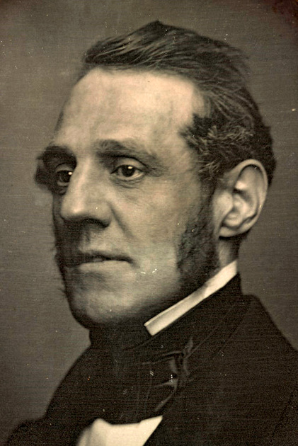
George Thompson

Slide 31
Boston Riot of 1835

Slide 32
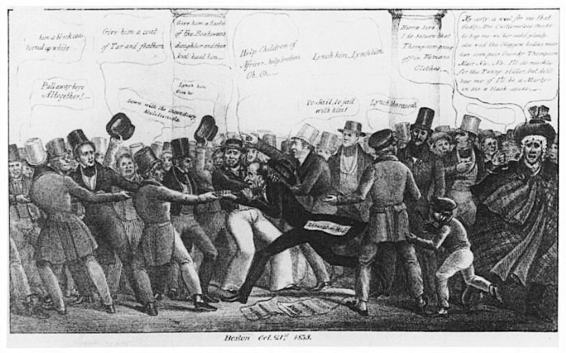

Slide 33
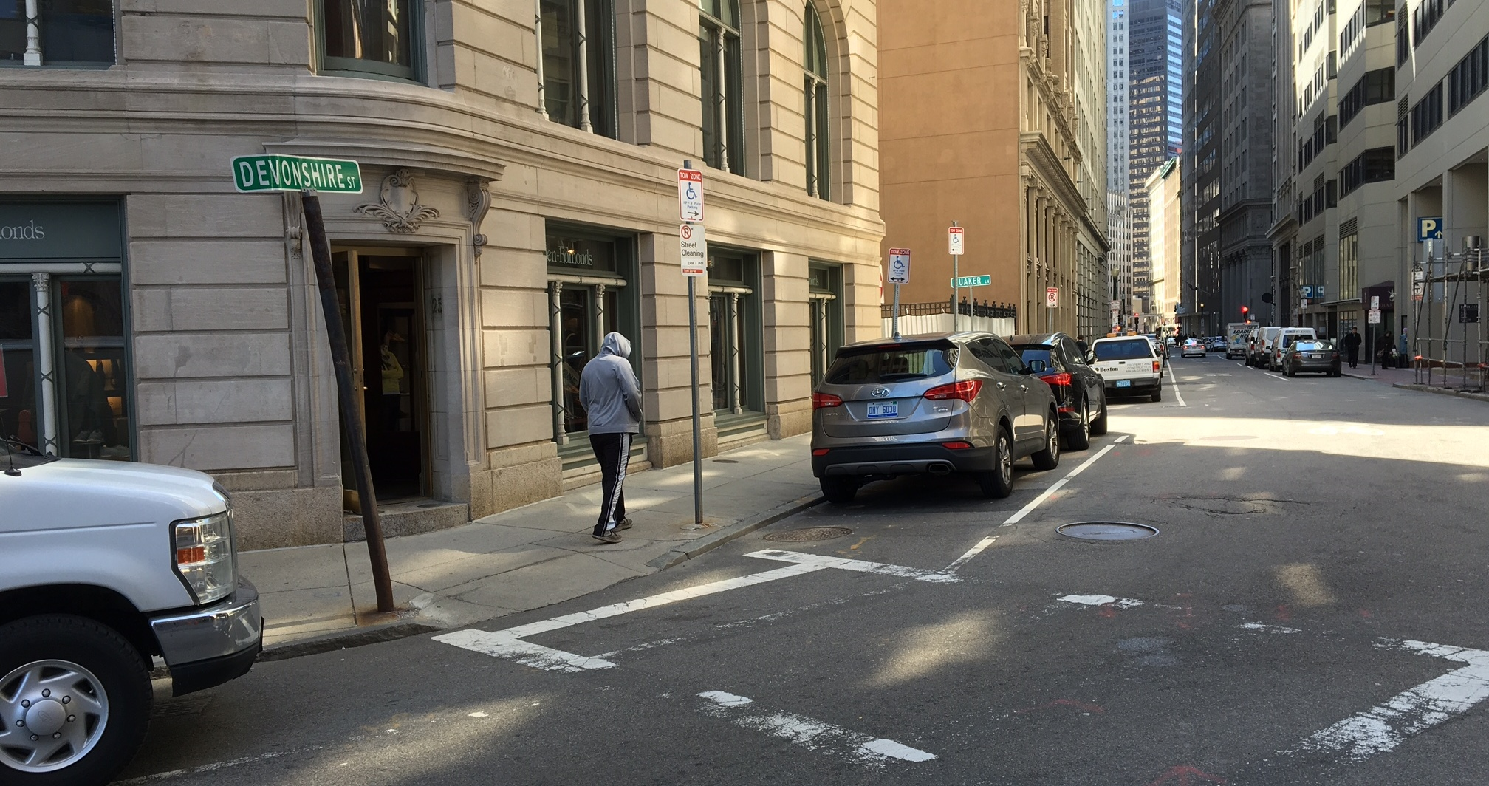

Slide 34

Notes:
https://www.illustrationsource.com/stock/image/505387/jail-cell-bars/
He lives to die another day → James Bond

Slide 35
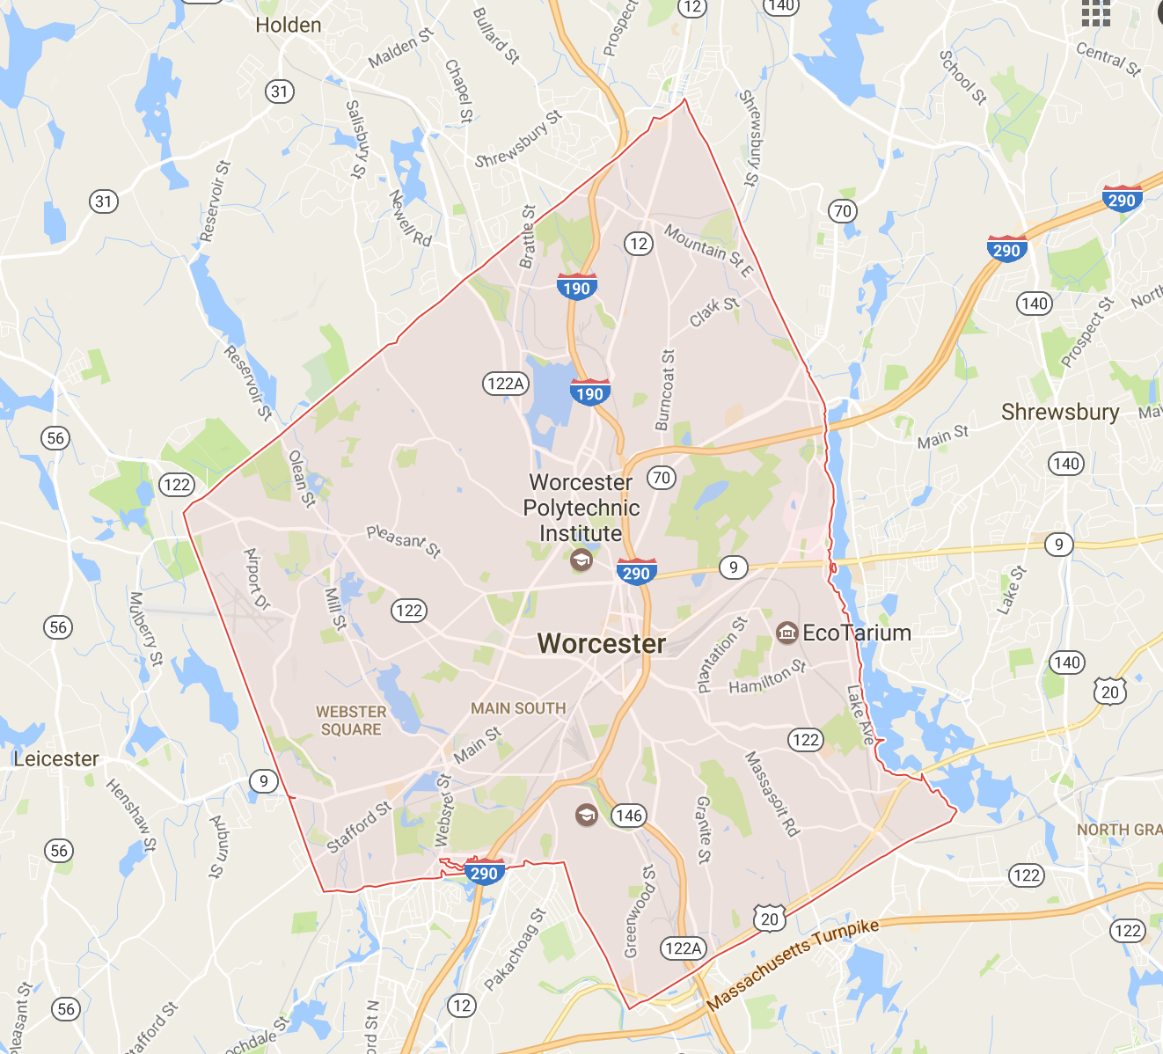
Worcester

Slide 36
1839

Slide 37
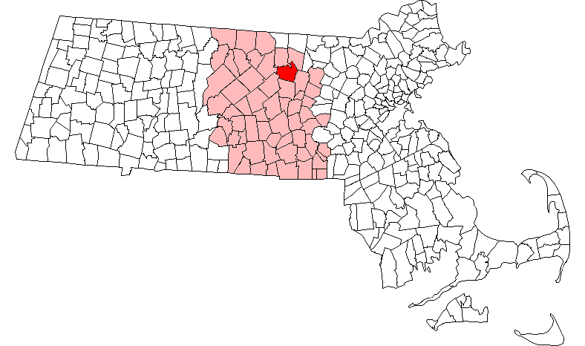
Nahum Hazard
Leominster
Worcester County
Notes:
***

Slide 38
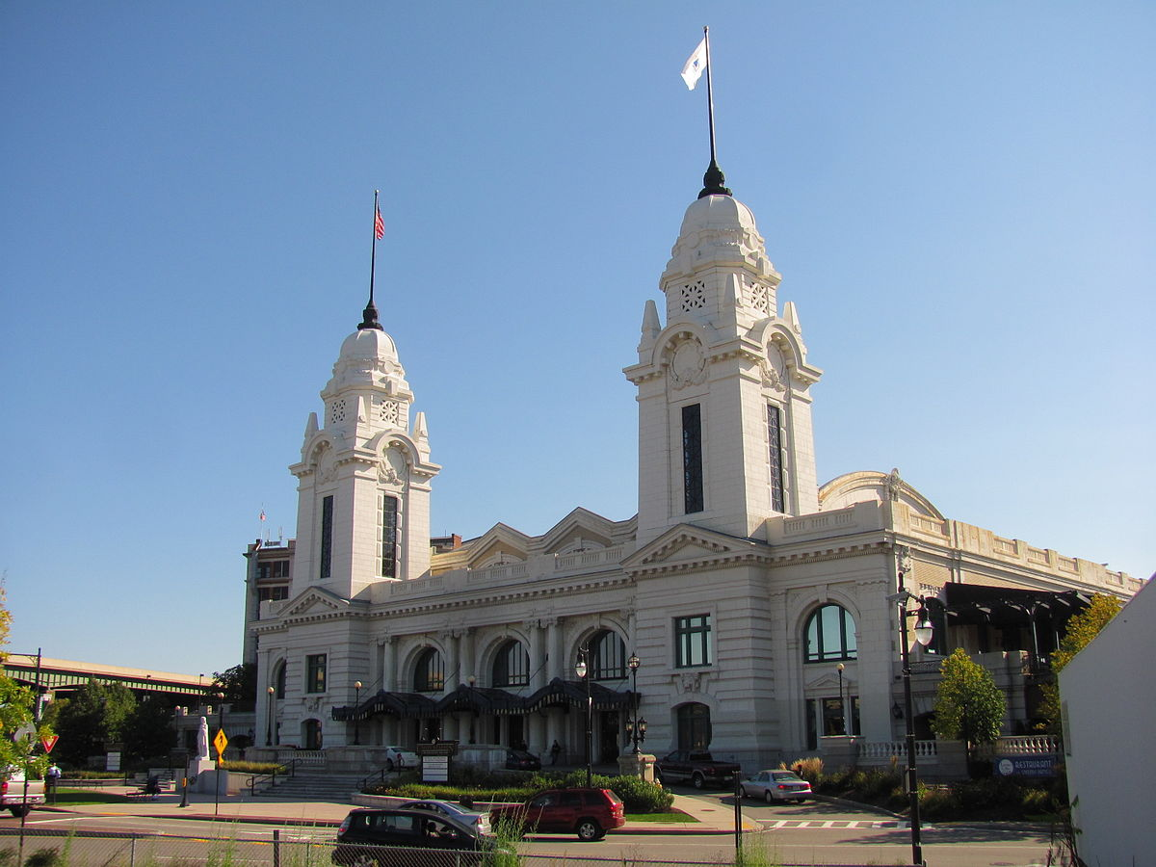
Sidney Francis → Pine Manor
Union Station, Worcester

Slide 39
3 Men

Slide 40
Elias Turner
Dickinson Shearer
Francis Wilkinson
Notes:
Elias Turner of Palmer.
Shearer → a former resident of Palmer who had moved away years ago, eventually ending up in Cartersville, Va., on the outskirts of Richmond.
Francis Wilkinson, a Virginia slave trader.

Slide 41
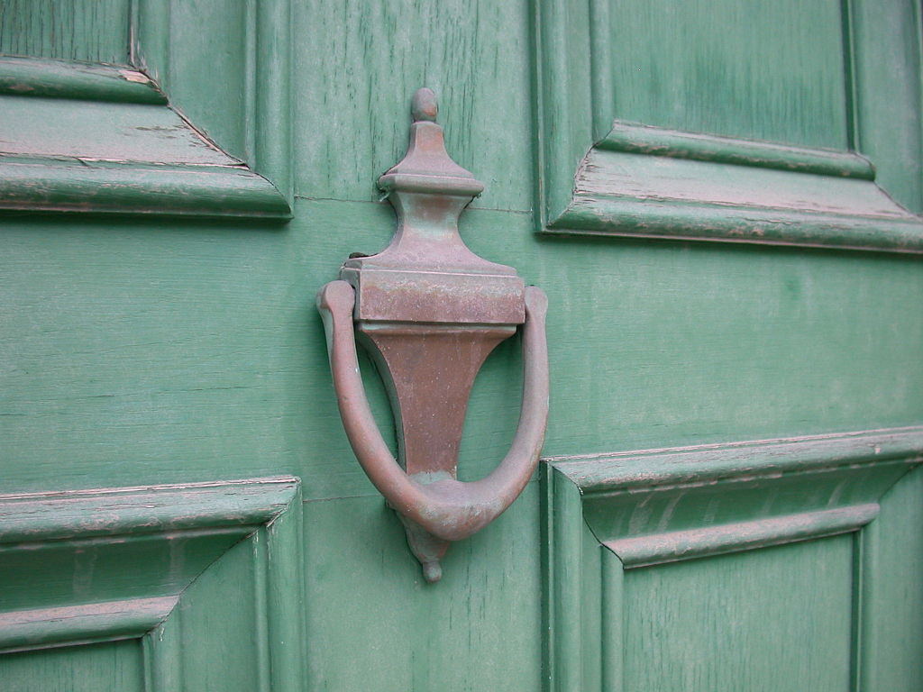

Slide 42
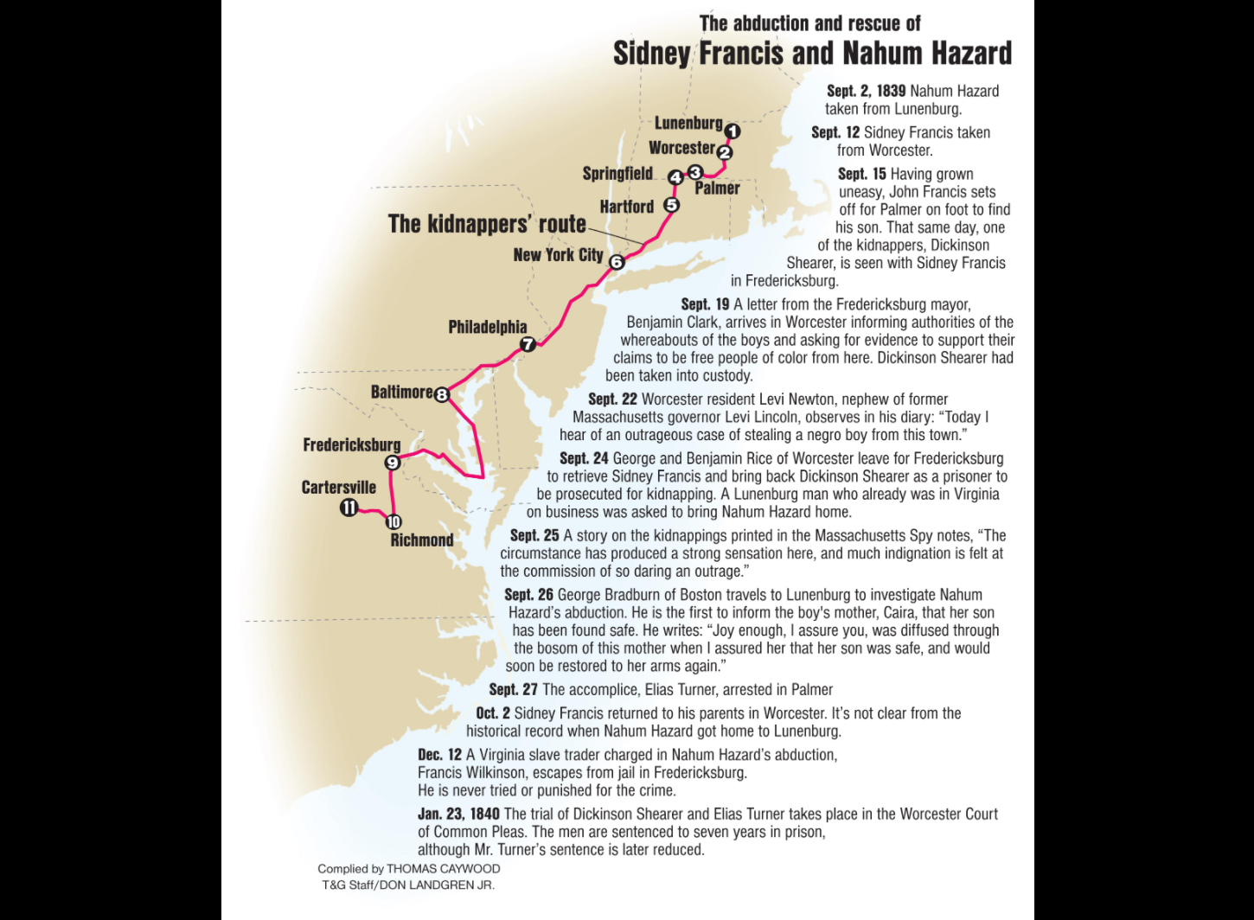

Slide 43
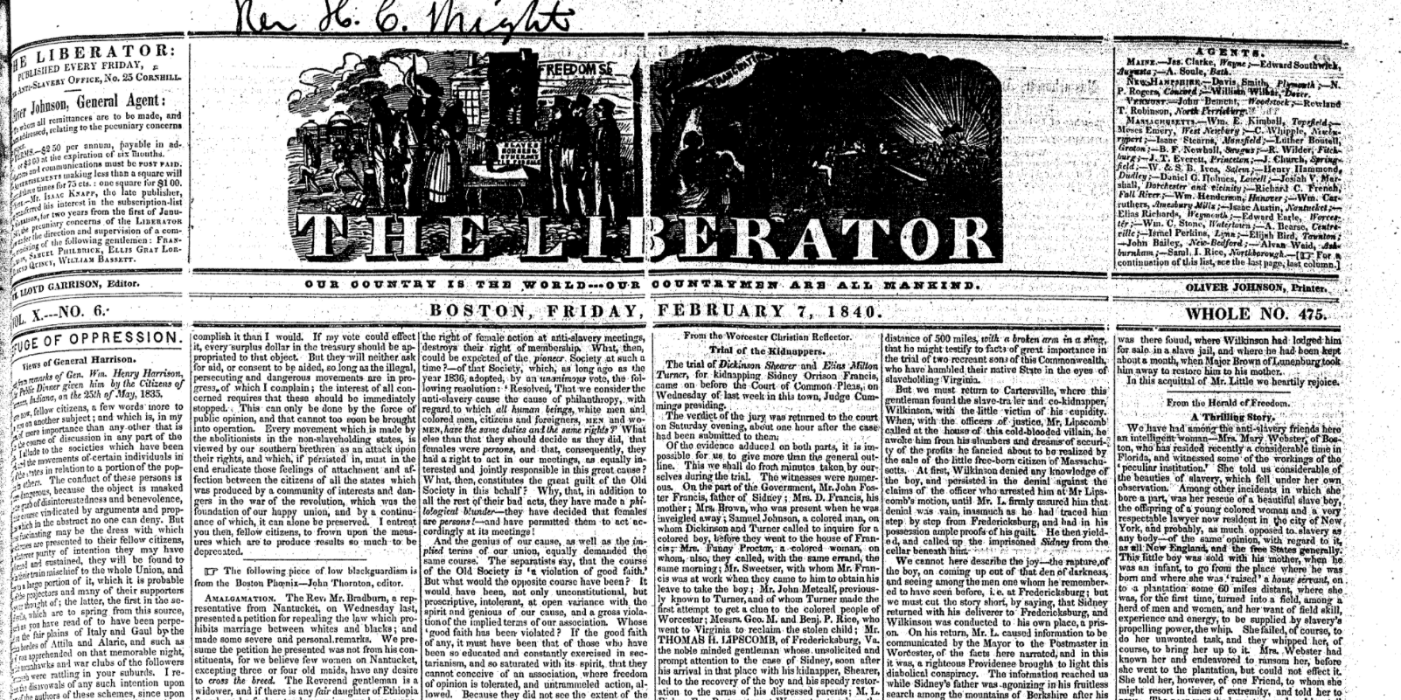
“Trial of Kidnappers” 1840

Slide 44
Returned Safely

Slide 45
✔ Elias Turner
✔ Dickinson Shearer
3. Francis Wilkinson
Notes:
Elias Turner of Palmer.
Shearer → a former resident of Palmer who had moved away years ago, eventually ending up in Cartersville, Va., on the outskirts of Richmond.
Francis Wilkinson, a Virginia slave trader.

Slide 46
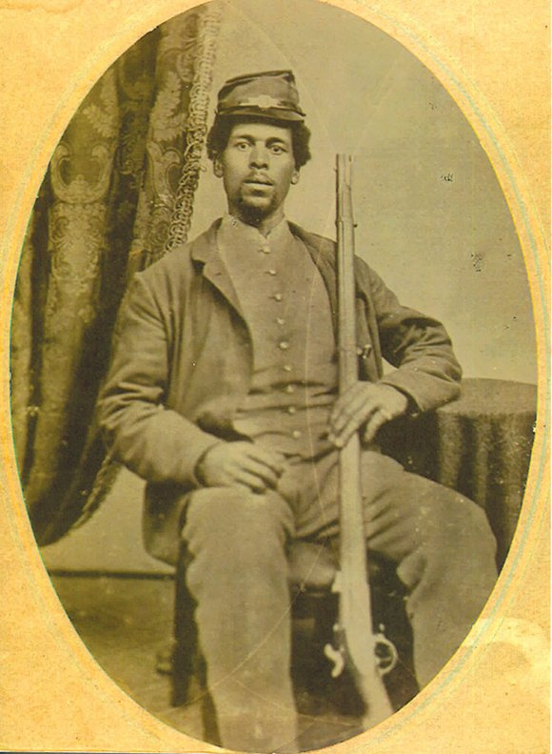
Nahum Hazard – 55th Regiment

Slide 47
1849

Slide 48
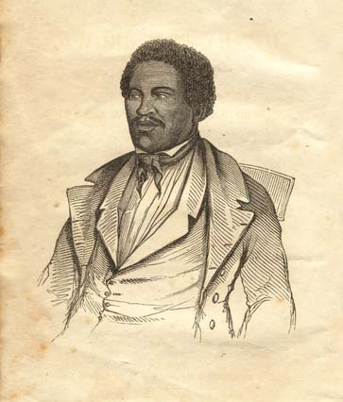
Henry “Box” Brown
Virginian Slave
Family Sold
Ships himself to Freedom
Box:
  3 Ft. Long
  2 Ft. Wide
  2.5 Ft. High
(1849)
Notes:
Received by…William Still, James Miller McKim, Professor C.D. Cleveland, and Lewis Thompson.
Upon the box being opened, Brown said, “How do you do, Gentlemen?” then recited a psalm: “I waited patiently on the Lord and He heard my prayer.” He then began to sing the psalm to the delight of the four men present, and was christened Henry “Box” Brown.

Slide 49
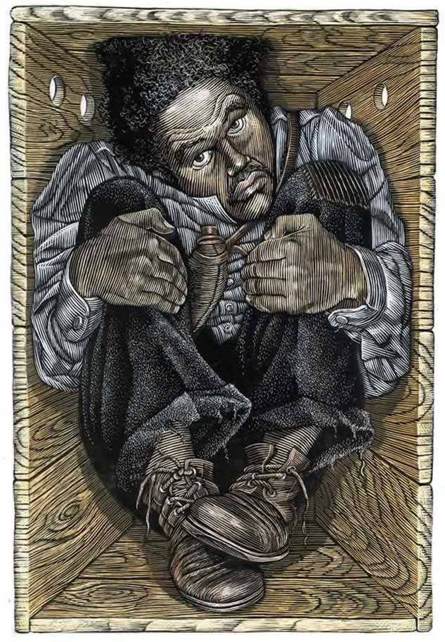

Slide 50
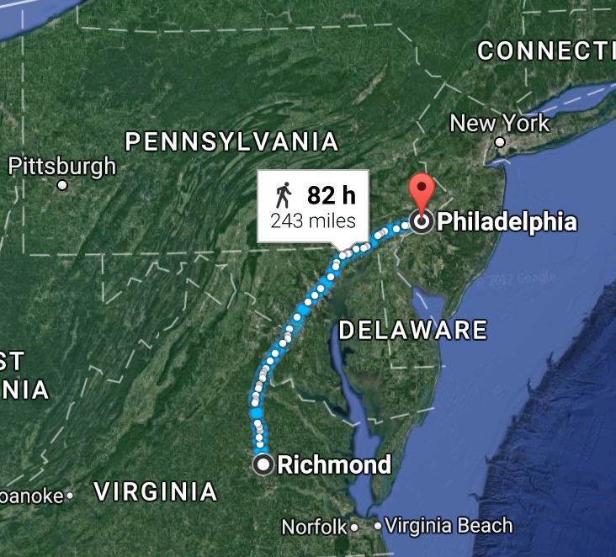

250 Miles
27 Hours

Slide 51
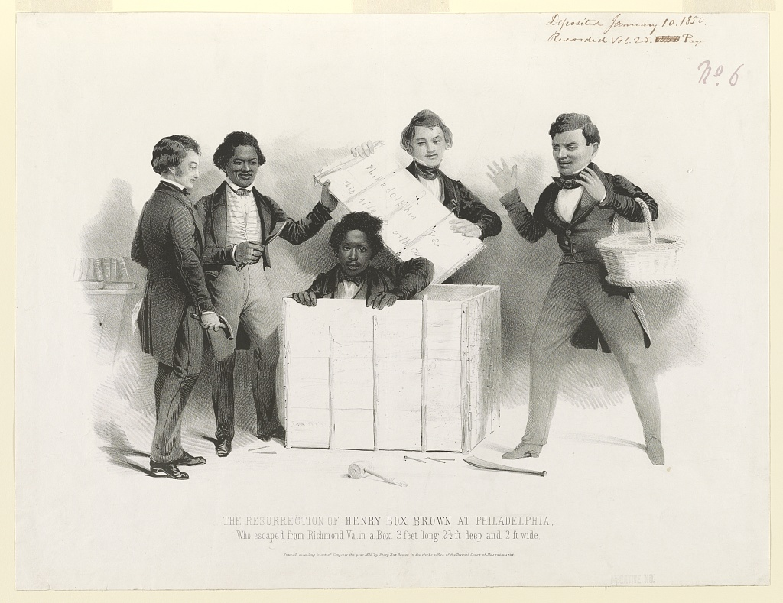

Slide 52
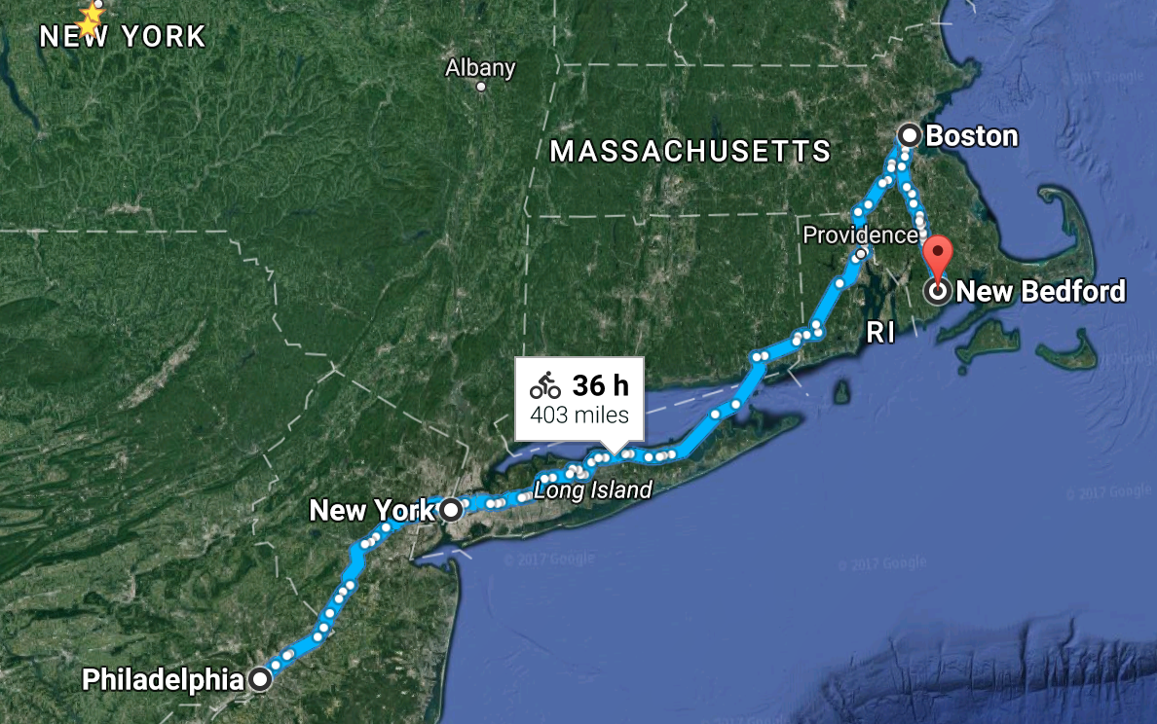


Slide 53
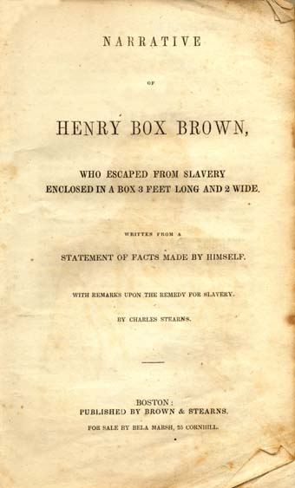

Slide 54
Boston

Slide 55
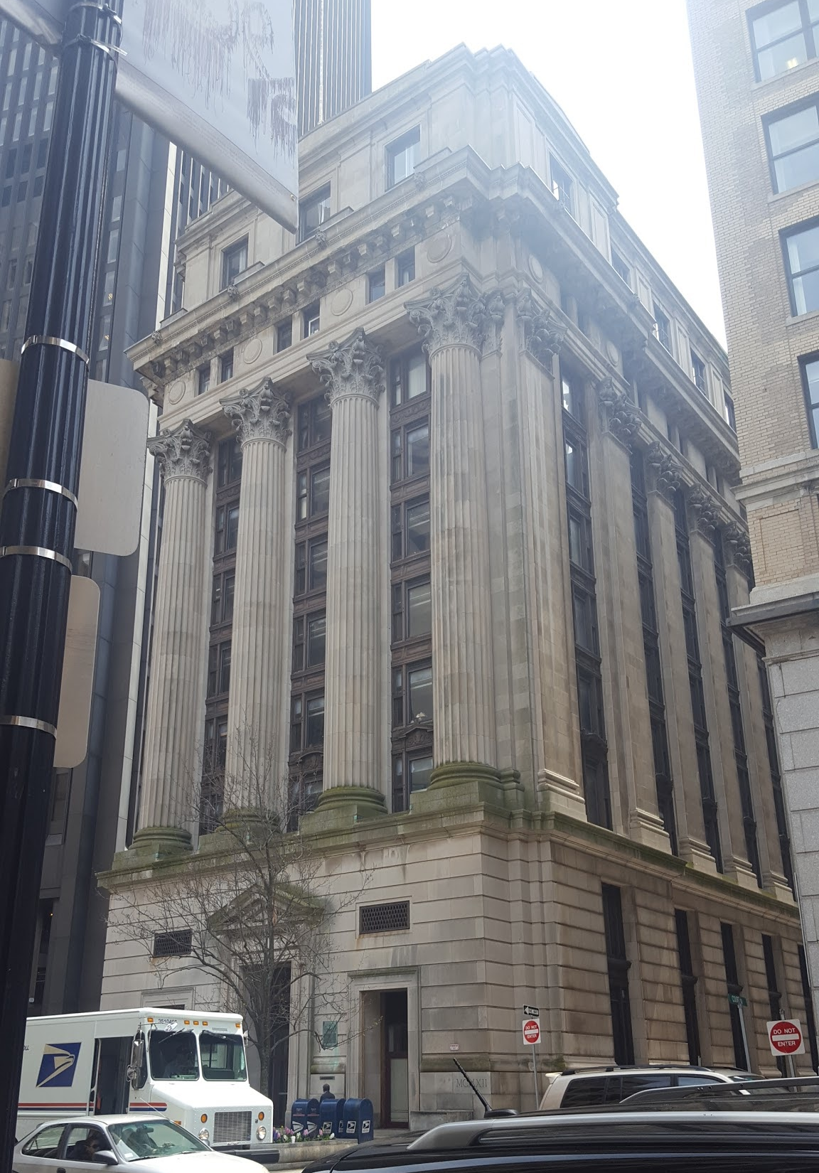

Slide 56
Department
of
Neighborhood
Development
Department
of
Education
Gaol
Courthouse
Courthouse

Slide 57
1854

Slide 58
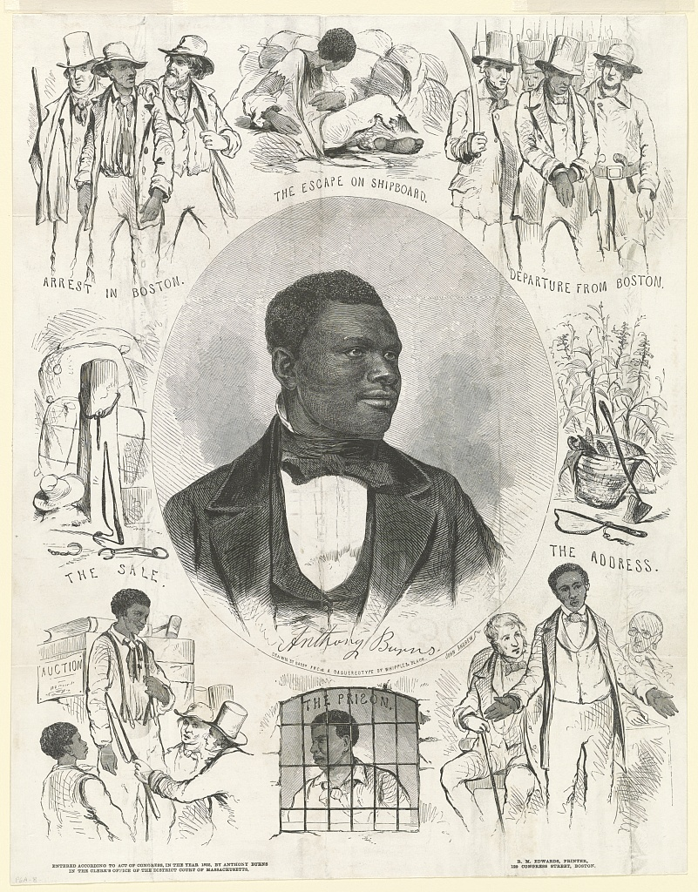
Anthony Burns

Slide 59
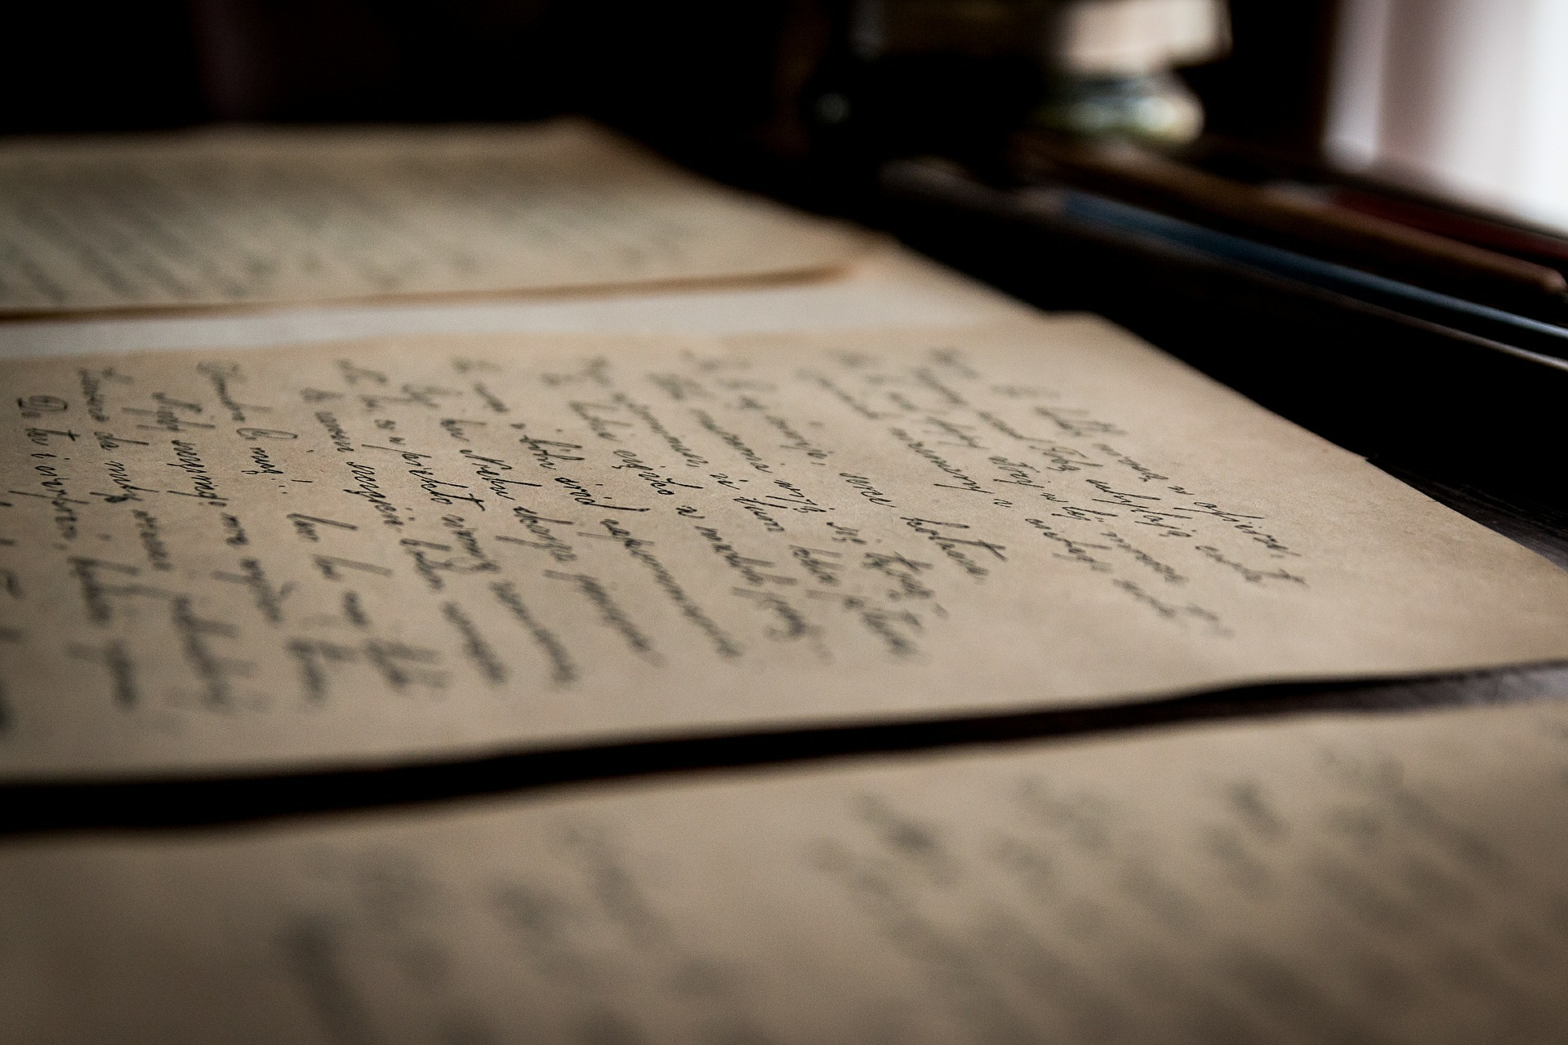

Slide 60

Former Master:
Charles Suttle.

Slide 61
Fugitive Slave Act (1850)

Slide 63
Rescue Attempt

Slide 64
Failed

Slide 65

James Batchelder
Stand-in Marshall
Sole casualty

Slide 66
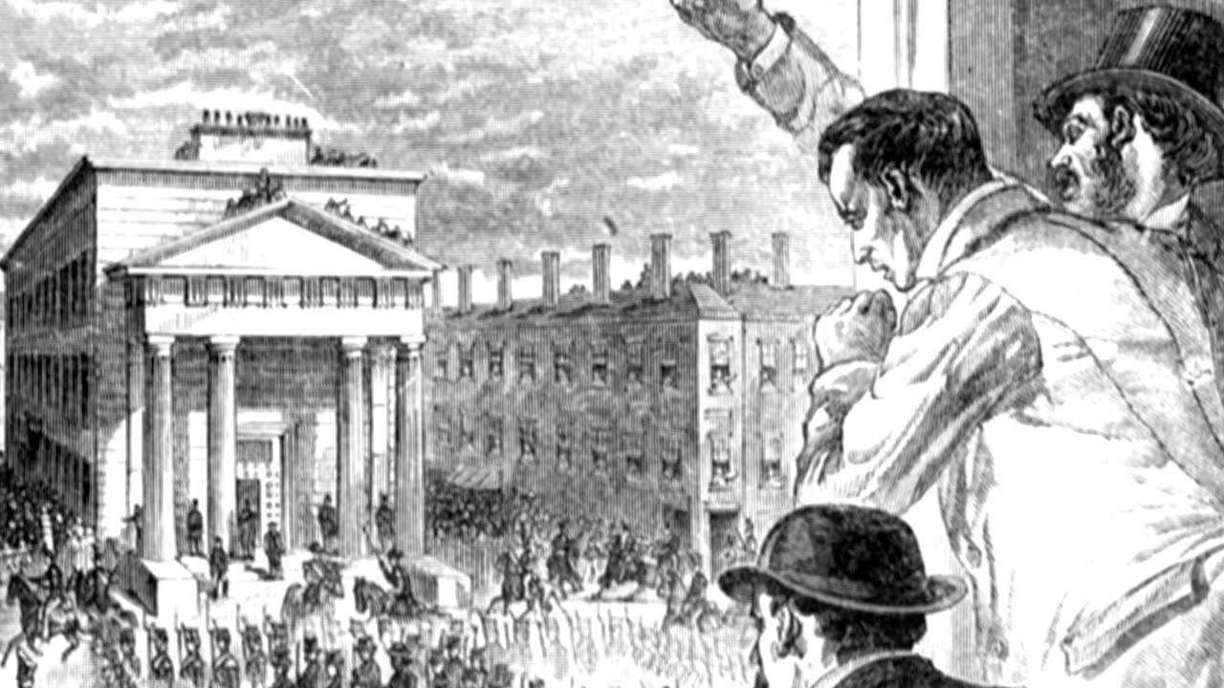

Slide 67
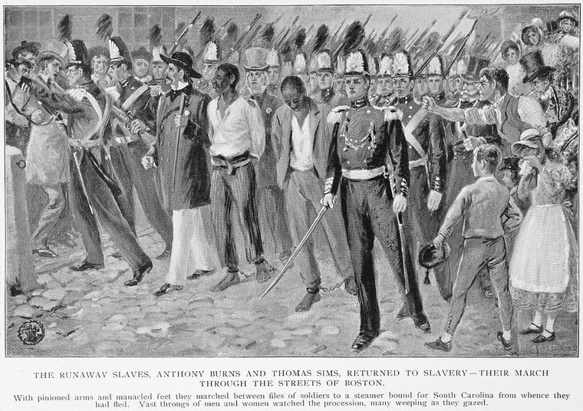

Slide 68


Slide 69

Liberty
State Street

Slide 70
Last Slave

Slide 71
Other Notable Abolitionists
Lydia Marie Child
William Cooper Nell
Maria Stewart
John S. Rock

Slide 72
WATCH!
Where You Walk…
Where You Stand…
Where You Sleep…

Slide 73
Be Aware!
Be Conscious.

Slide 74
Thank You!
Professor Kevin Aylmer
Dan Kennedy

Slide 75
Questions?

Slide 76
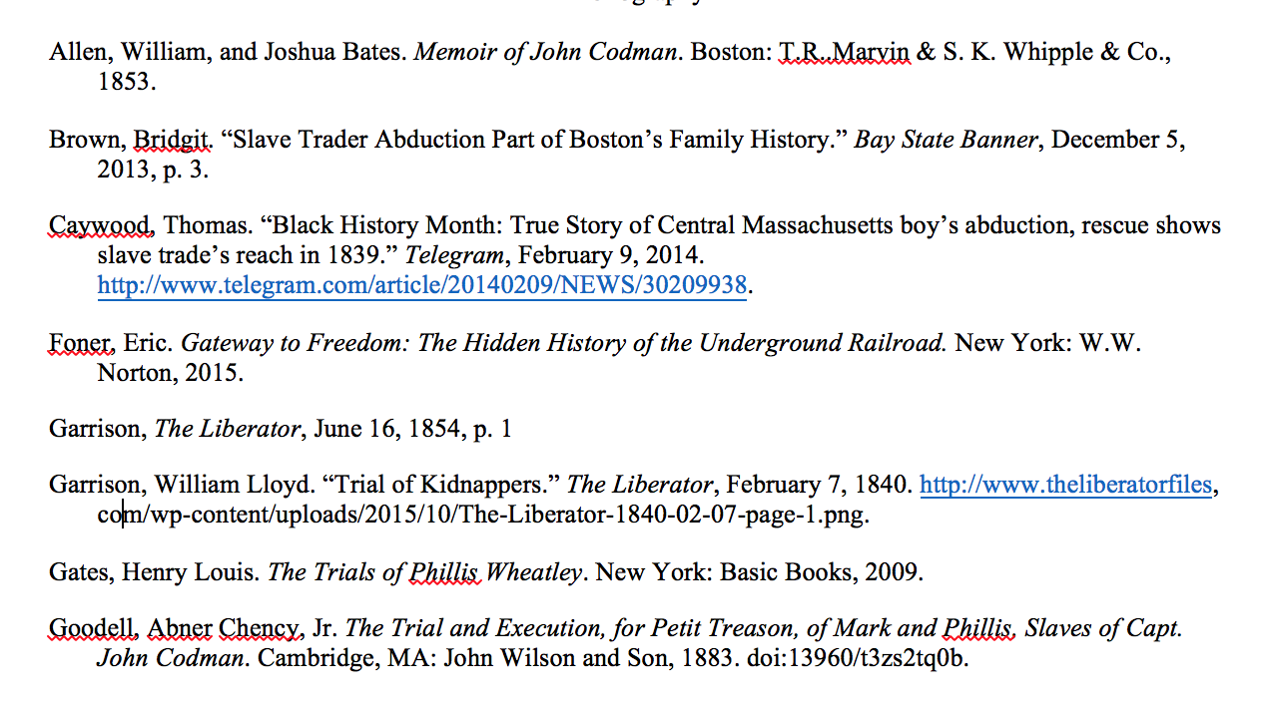
Bibliography:

Slide 77
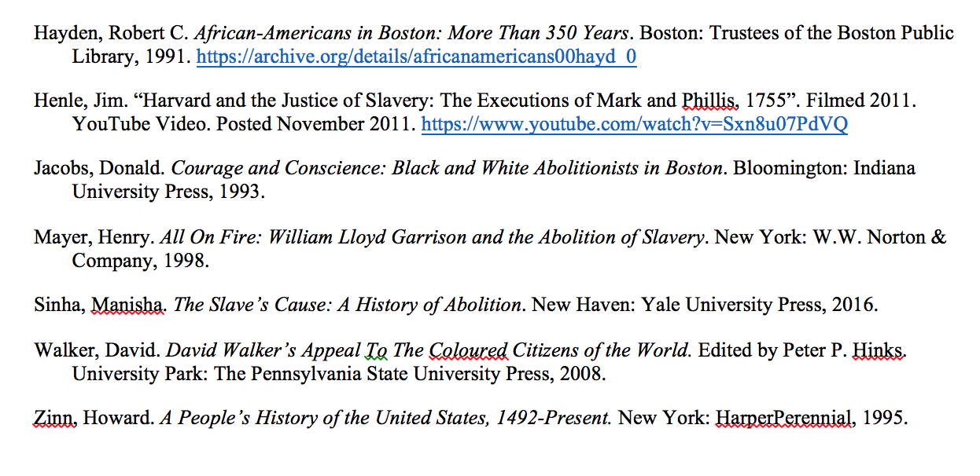
Bibliography:

Slide 78
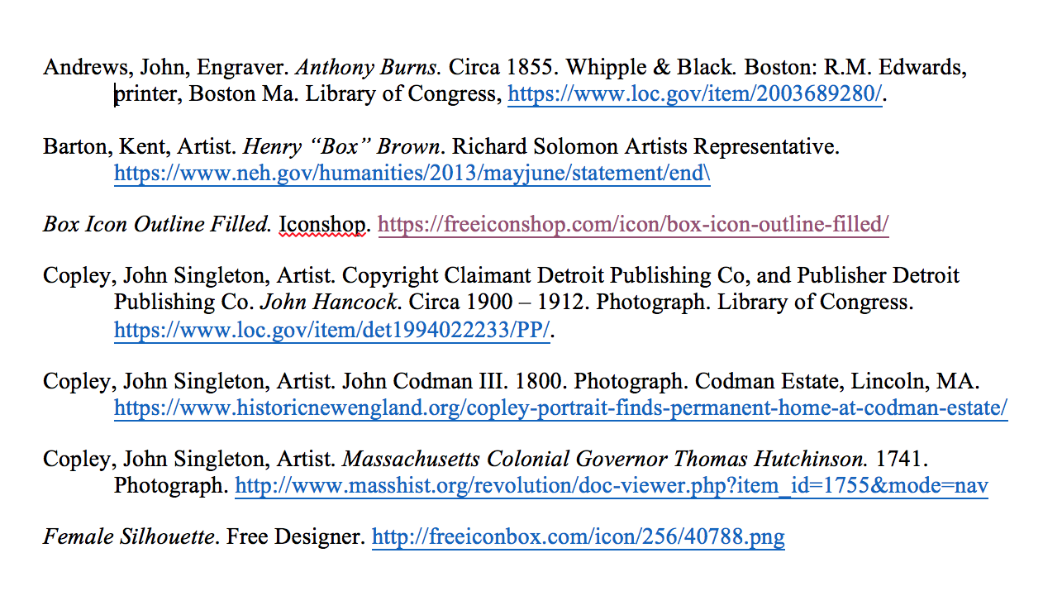
Bibliography (Images):

Slide 79
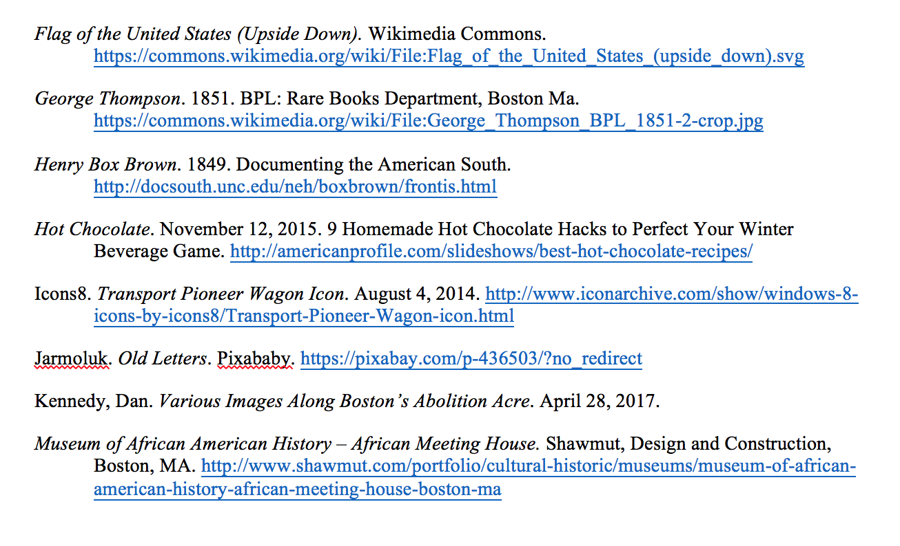
Bibliography (Images):

Slide 80
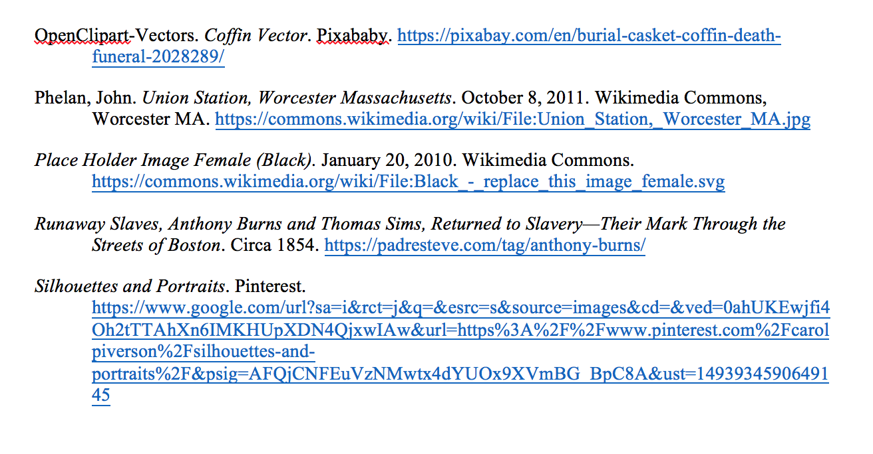
Bibliography (Images):

Slide 81
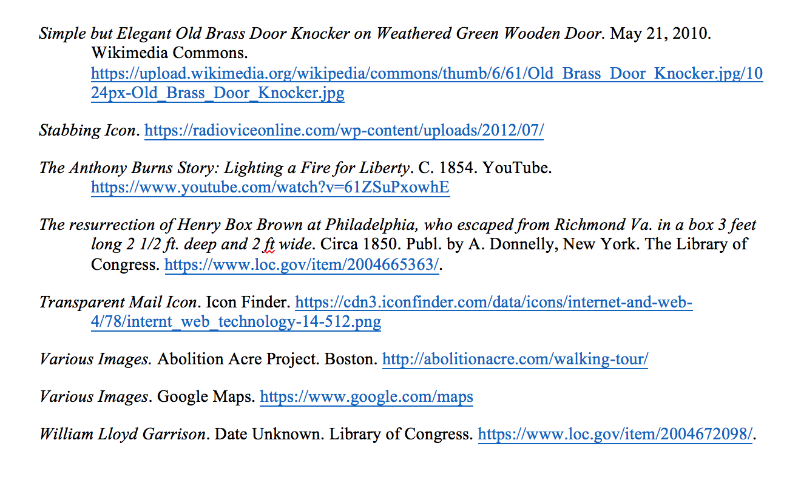
Bibliography (Images):

